Slide 1



Heat Pumps
There’s Energy in the Air
Eric Dubin, Senior Director
Utilities and Performance Construction
June 21, 2019
Notes:
Tremendous growth in programs. We are doing our best to consult with those that are both renewing existing programs, like those in the Northeast and Northwest, and those around the country that are just now taking their first dive into electrification programs with heat pumps.

Slide 2
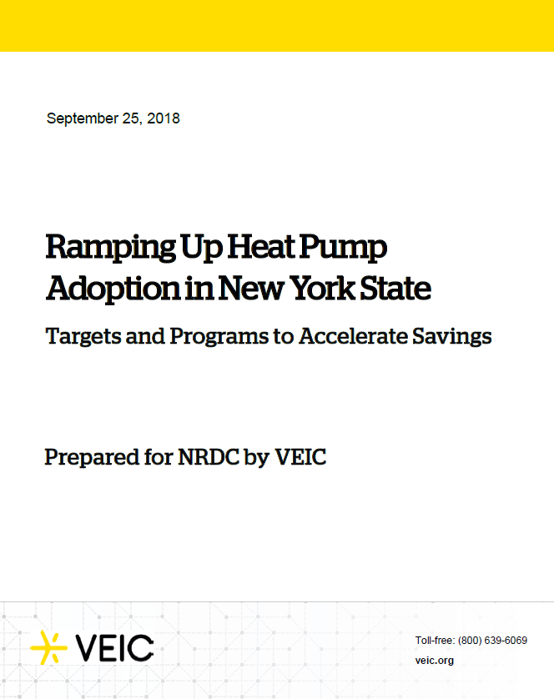
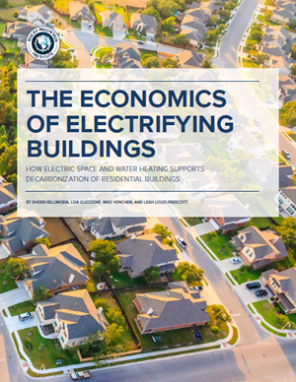
EE and Climate Policy = Strategic Electrification
Transportation = EV’s
Building Decarbonzation = HP’s
Notes:
Over this past year, nearly every environmental organization, implementer, utility, states, cities have created a report showing that electrification is the pathway to address climate change… EV’s for vehicles, and heat pumps for building decarbonization. They all agree that Heat Pumps are the future of building heating and cooling in the US.
We are at the INTERSECTION of SCIENCE and TECHNOLOGY…. This issue is going to be solved using technology that has only been available to us for a short period…
It is OUR equipment, HEAT PUMPS, that are the present and Future solution to a past problem!!

Slide 3
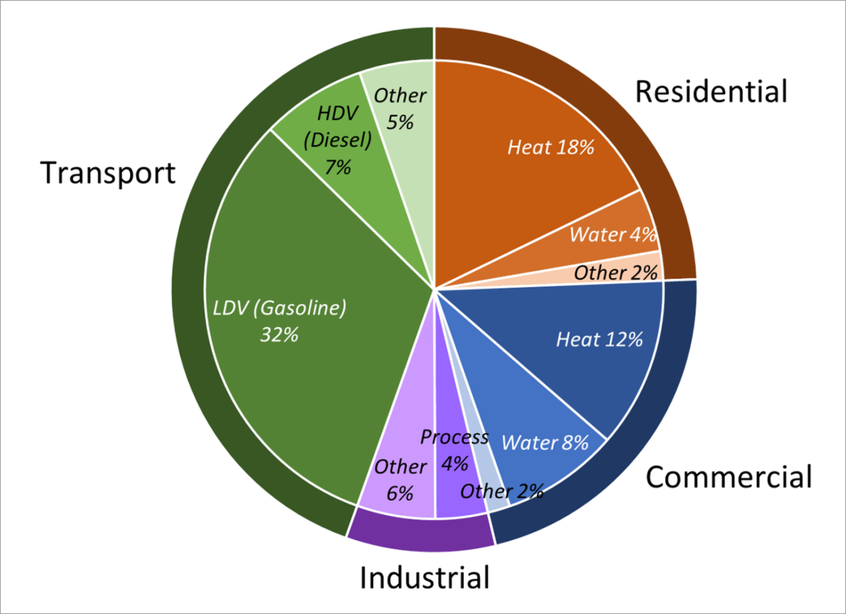
Why Strategic Electrification?
Fossil Fuel use [ex: New York and New England]
46% of Fossil
Residential & Commercial Space and Water Heating
Residential and commercial buildings account for approximately 40% of the Nation’s total energy demand and about 75% of all electricity use.
4.2 Quadrillion BTUs per year of direct fossil fuel use
Notes:
What is Strategic Electrification. Concept is simple… decarbonize our electric grid by integrating more renewable electricity powered by wind and solar. Then converting the heaviest GHG intensive users to electricity. Electrify EVERYTHING. For example, this chart shows that two major sectors are the highest users of GHG intensive fossil fuel use… light duty and heavy duty vehicles and commercial and residential buildings. This explains the recent emphasis on electric vehicles to address the transportation sector. Likewise, it is Heat Pumps that are being identified as the PRIMARY source of electrification in the builder sector. In fact, 46% of all fossil use is attributable to residential and commercial space and water heating. This is a very powerful endorsement for why our products are prime for huge growth.

Slide 4
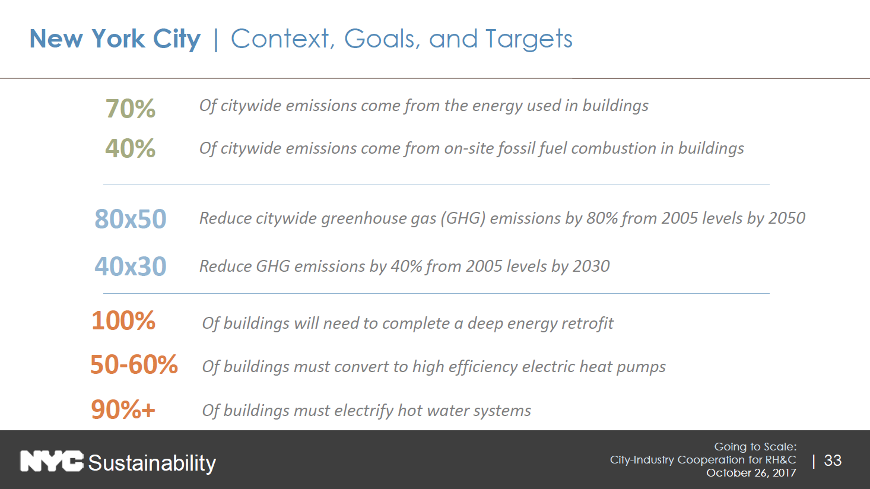

Slide 5
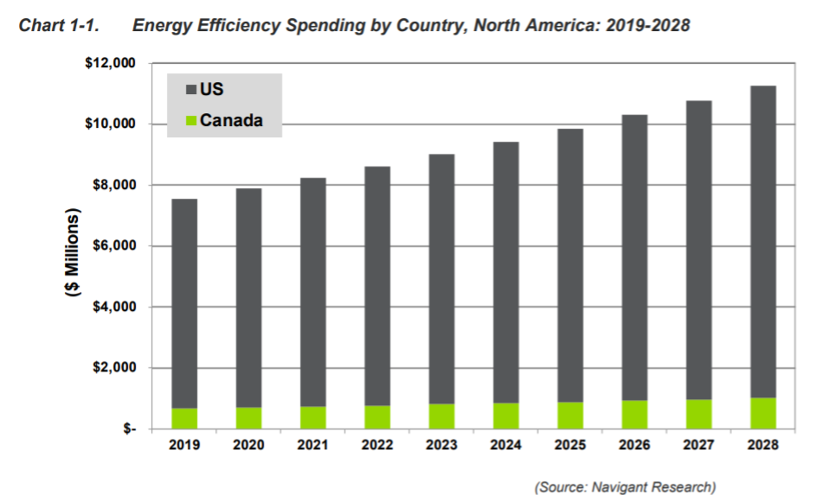
EE Spending Rising
Transfer to Electrification Programs?
Efficiency Spending:
$11 Billion/Yr
Electrification Programs
-New Incentives
-Reallocation of existing incentives
Notes:
At the same time as spending increases to generate renewable electricity, the DEMAND side (the use of energy), is seeing record spending. Energy efficiency spending in North America is predicted to continue to grow significantly over the next decade, and according to Navigant to nearly $11 Billion per year.
Regarding ductless and VRF, we are seeing a double benefit –
-an incredible amount of NEW heat pump programs that are being created.
-an incredible amount of replacement programs – hug portions of that $11Billion being taken away from the former fossil fuel programs, and being reallocated to heat pumps!!

Slide 6
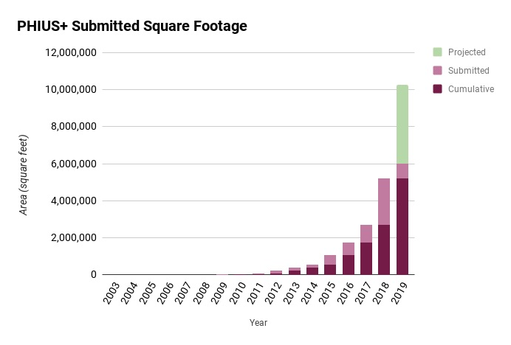
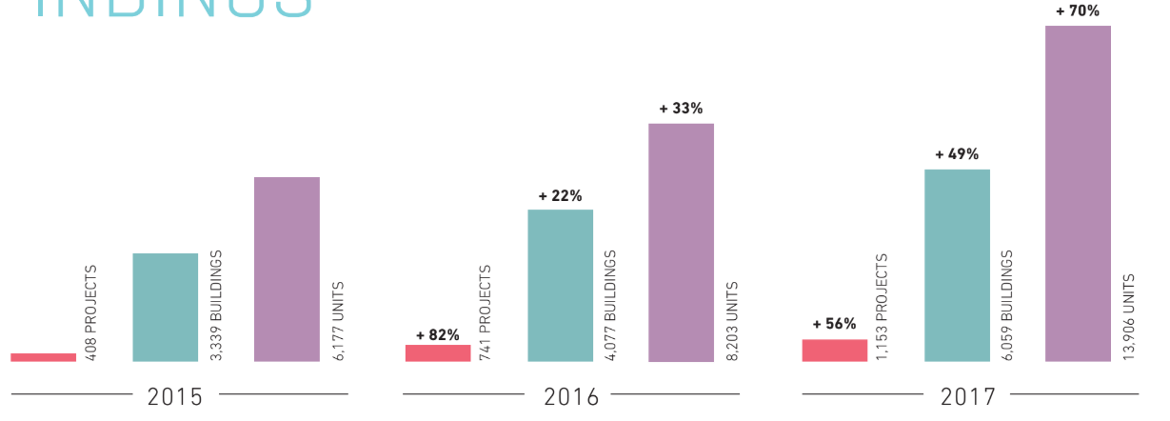
Emphasis on Building More Efficiently
Recent Above Code Growth
Mandates
Stricter building codes, Legislation, Renewable Standards
Voluntary programs
Energy Star, Passive House
ZNE – produce enough energy onsite to meet own annual demands
Heat pump electrification applications
First quarter of 2019: PHIUS has received submissions for PHIUS+ certification for more than 500,000 square feet of passive buildings.
Notes:
At the same time, we are seeing tremendous emphasis on building more efficiently. We are seeing more and more impactful policies that are both MANDATED and VOLUNTARY.
Mandates would include more stringent building codes, like CA Title 24 requiring all new construction to be net zero by 2020, or stretch codes that many of you are seeing in your states, cities and municipalities.
Voluntary programs include things like Passive House, Energy Star Homes, and the fast growing trend to build ZNE.
Zero (net) energy (ZE, ZNE) – buildings produce enough energy onsite to meet its own needs on an annual basis.
2017 saw a 70% increase in ZE units, versus a 33% increase in 2016. Growth in 2018 is expected to be even greater…

Slide 7
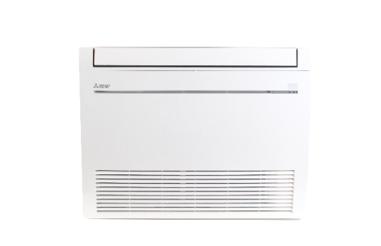
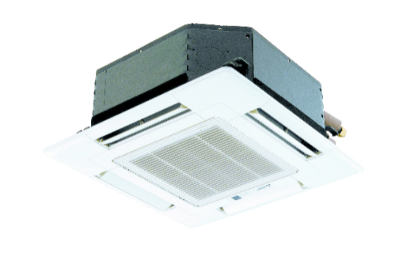
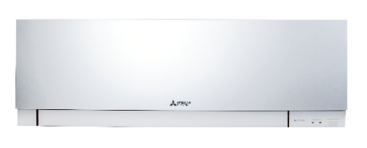
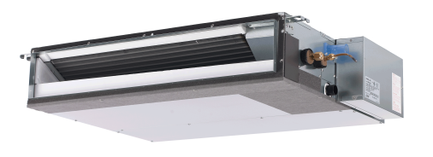


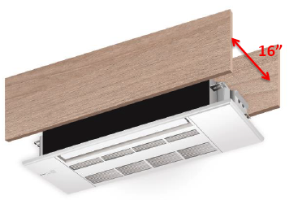
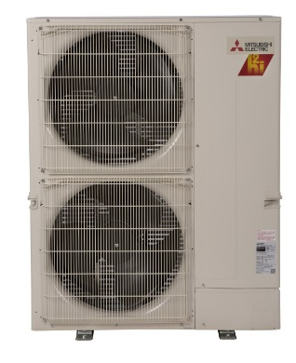
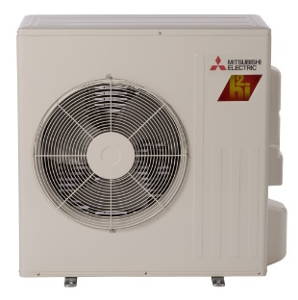
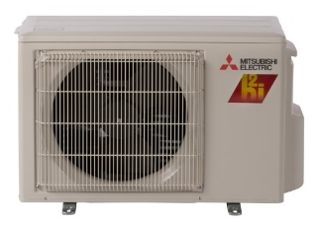
Technology Advancements
Zoned Comfort Solutions™

Slide 8
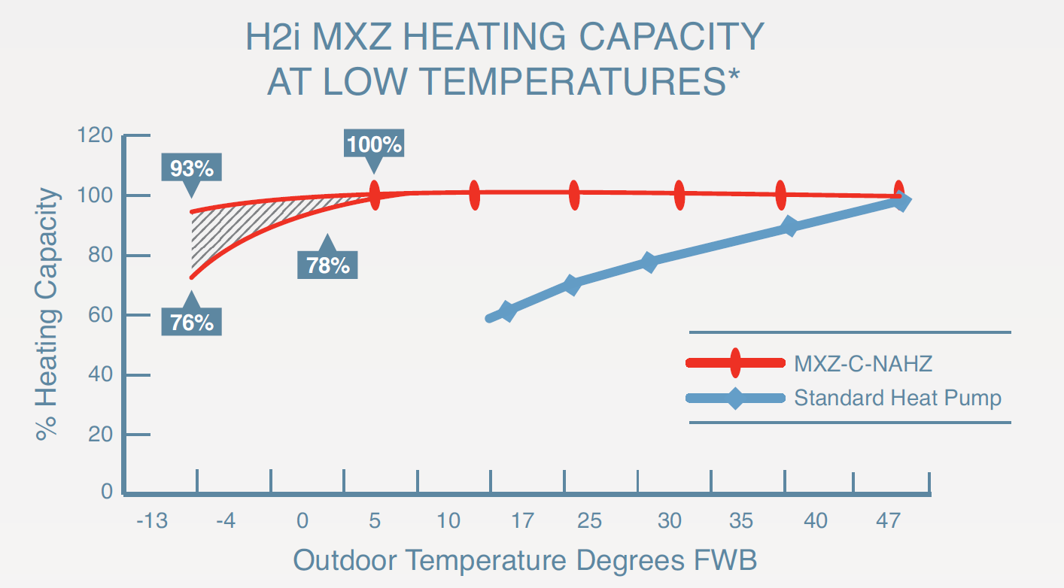
Hyper Heat - A Game Changer
Enables Heat Pumps to Heat at Very Cold Outdoor Temps
Cold Climate Capable
  100% capacity at 5 F.
  ~82% capacity at -13 F.

Slide 9
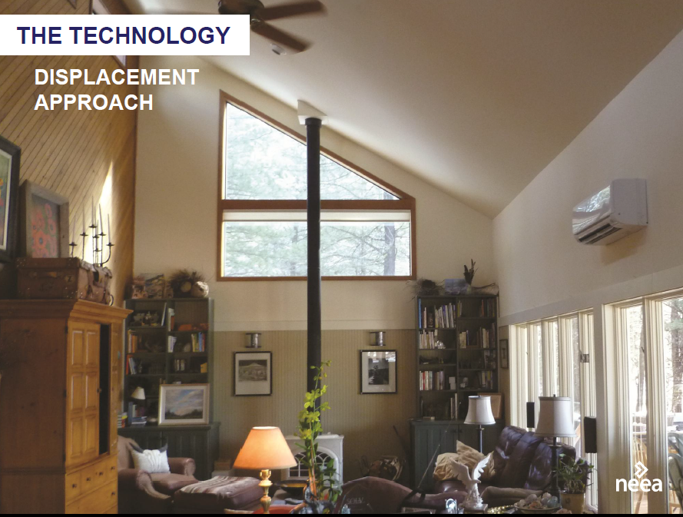
Retrofit Opportunities
Displacement Approach:
Leave existing system in place
Condition rooms where people spend the most time
Common strategy in Northwest
Replacement Approach
Completely replace existing system
Increasing push in Northeast

Slide 10

What Keeps Me Up at Night?
The number of initiatives overwhelming
  Need to help program design
  Designing to metrics w/o regards to whether products exist
Time of Use Rates – Coincident w HPs
  Need for storage
No Black Eyes – Pilots must run smooth
Installer, Architect, Engineer Education
  Not enough!
Simplicity
LMI – How to motivate landlords?
Consumer Education/Awareness
“Hidden Barriers”
  Utility Natural Gas Rebates still exist !!
  Breakdowns and need for Early Retirement

Slide 11
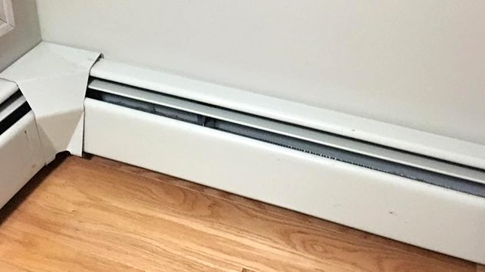


Consumer Education/Awareness
Challenge is to Educate a…Confused Market?
Not your father’s Heat pump
1980’s
Electric Baseboard Heat
1990’s
Delivered Fuels – Oil/Propane
2000’s
Natural Gas
2010’s
Heat Pumps
Notes:
Do you think we have a confused market out there? I mean, we spent the last 40 years confusing the public about what they should heat their homes with. In the 70s it was the Oil embargo and we try to convince people to convert to electric heat. In the 80’s it was a conversion to delivered fuels, and things like propane and oil trucks dotted the neighborhoods. In the 90s we tried to convert people from oil to natural gas. The 2000s now we’re trying to get people off of electric you an offer will end up electricity back in the public not be confused.
The important point is HOW we communicate that the technology has changed, both:
-Yes we are asking you to go back to the future and consider adopting ELECTRIC heating and cooling
– heat pumps are now much more efficient and able to heat to low temperatures – this is not your father’s heat pump…

Slide 12
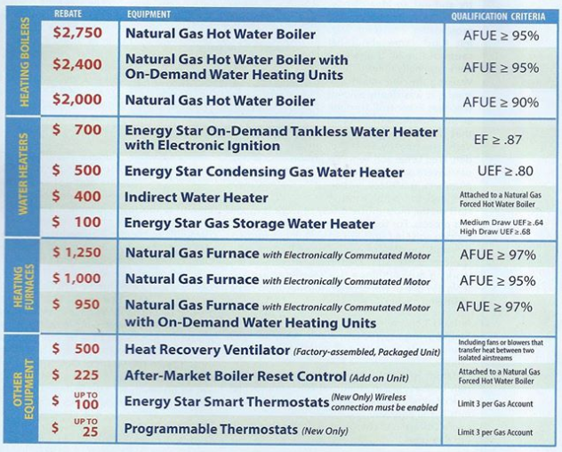
Fossil Gas Still in Play
Confused Market?

Slide 13
The Case for Early Retirement and Offseason Programs
>80% breakdowns occur in “Emergency Mode”
Fall Peak
Spring Peak
20
15
10
5
0
Off Season rebates
Early Retirement Pgm
Capacity
May Jun Jul Aug Sep Oct Nov Dec Jan Feb Mar Apr
Notes:
In another example of program development, we are working with utilities and states to create programs that have impact. We know that most breakdowns occur in the peak periods where the HVAC systems is under more strain. The graph above illustrates (with a fictitious capacity curve) how a contractor is capacity constrained in Fall and Spring – turning work away. Knowing these two facts, how can we incentivize customers to take action to replace a system PRIOR to failure when it is more likely that they will replace like-for-like, and not make the transition to a heat pump (which is not necessarily as easy to complete for an emergency, but rather more of a planned replacement), as well as take advantage of times when contractors have capacity. We call these early retirement programs….

Slide 14

Electrification is Real!
Heat Pumps are the solution!
We need to BE THERE
-New Construction
-HVAC Retrofits
A mighty challenge is a gigantic opportunity!!
Notes:
It would be amazing if we had a fresh pallete like this, to build amazing energy efficient structures from scratch…
But unfortunately our pallete looks like this… incredibly inefficient buildings, crowding the landscape. It will take a monumental effort to improve the efficiency and reduce the pollution being sent into the atmosphere from cities like New York.
But the best news of all is that Heat Pumps are seen as THE solution on the demand side for buildings. We just need to BE THERE for every new construction building and every building undergoing an HVAC retrofit – a mighty challenge, but an a mighty opportunity indeed….

